Slide 1






AuctionNest
America’s Auction House
TEAM 7
TRI-ALLIANCE
SAMEER SHAIK
VIVEK KOMMAREDDY
PRAKYA CHOWDARY

Slide 2



Option 1. Design three parts of an Auction Site: Registering products to sell, Bidding on an item, Payment Module
Scenario: In an effort to establish a secure and trustworthy online auction site, our organization has set out to develop Auctionnest- a platform focused on safe buying and selling, designed with the latest security and verification protocols. Auctionnest caters to individuals who want a reliable and transparent auction experience, eliminating common concerns such as fraud and unverified users.
The development will focus on three essential parts:
1. Registering Products to Sell: Sellers can register products with detailed descriptions, images, and starting bids. Each product undergoes an automated verification process to ensure listings are accurate and legitimate.
2. Bidding on an Item: Buyers can participate in real-time bidding, with secure notifications on bid status and set maximum bid amounts. The system will provide fair and transparent bidding with a secure transaction framework.
3. Payment Module: Auctionnest integrates a secure payment system, supporting encrypted transactions and offering multiple payment methods to ensure safety and flexibility for users. Funds are held securely until both parties verify the completion of the transaction, fostering a reliable payment experience. And later followed by the customers review of the sellers.
Auctionnest emphasizes secure transactions through encrypted payments and a rigorous user verification process. The goal is to provide a safe environment akin to Facebook Marketplace, but with added safeguards that prioritize user trust, ensuring a smooth and protected auction experience for all participants.

Slide 3

Review of System Design Document
The system design document for Auctionnest provides a comprehensive outline of the technical and functional components required for a secure and reliable online auction platform. It uses a structured approach to present the project’s vision, core functionalities, architectural layout, data model, and user interface design. The document includes detailed diagrams, use cases, and data flow models that serve as vital references for all stakeholders, ensuring a shared understanding of system requirements and implementation pathways. By detailing each aspect of the application, this document supports effective project planning and coordination, aligning the development team and guiding them toward achieving the project objectives for Auctionnest.

Slide 4

Project Scope
The Auctionnest platform will enable users to securely participate in online auctions, providing a safe environment for both buying and selling. Key features include streamlined product registration, an intuitive bidding system, and a robust review system for sellers, which promotes trust and transparency. With a focus on secure transactions, encrypted payment options, and strict user verification, Auctionnest aims to create a trusted online marketplace where users can confidently engage in auctions. This platform offers a comprehensive solution for secure and reliable online auctions, fostering a fraud-free community for both buyers and sellers.

Slide 5

Review Modules of the System
Registration Module: Ensures secure user sign-up by validating email, phone number, and identity documents to establish user credibility. Provides an intuitive and streamlined onboarding experience, making it easy for new users to register and start participating in auctions. Collects essential information with user consent, following strict privacy standards to protect personal data. Stores user profiles securely, enabling personalized recommendations and ensuring all interactions are traceable and secure. | Auction and Bidding Module: Allows users to register items for sale, including detailed descriptions, images, and initial bid settings, with secure moderation. Provides real-time bidding features, enabling users to place, view, and monitor bids with immediate status updates and notifications. Supports automated bidding options, allowing users to set maximum bid amounts and receive updates on their bidding status. Ensures seamless access and bidding capabilities across multiple devices, allowing users to participate in auctions from anywhere. | Payment Module: Integrates an encrypted payment gateway, ensuring secure transactions between buyers and sellers and supporting various payment methods. Holds funds in escrow until both parties confirm transaction completion, enhancing user trust and reducing fraud risks. Offers payment flexibility, allowing users to choose best method suited to their needs while safeguarding financial information. Provides transaction history and payment verification, enabling transparent records and reducing potential payment disputes.

Slide 6

Review User Interface Design
The Auctionnest UI is designed for a seamless, user-friendly experience, enabling secure user authentication, efficient auction navigation, and intuitive item management.
Login Page: Features secure user authentication with "Login" and "Sign Up" options to ensure a personalized, protected experience for all users.
Home Page: Displays the Auctionnest logo and quick-access options for "Buy," "Sell," and "Auction." This layout allows users to easily navigate to their desired sections.
Auction and Bidder Page: If users select "Auction" or "Buy," they are directed to the Bidder Page, displaying items available for bidding or purchase with item details, current bid amounts, and a place-bid option.
Seller Page: Clicking "Sell" directs users to a dedicated page to register items for sale. Sellers can provide item details, images, and starting bid prices.
Cart and Inventory Management: A cart page allows users to view items they have added for purchase, integrating inventory management features to track purchased items and show current auction statuses.
Payment Module: Provides a secure payment gateway, supporting various payment methods and offering an escrow system to ensure safe transactions.
Responsive Design: Optimized for desktop, tablet, and mobile, ensuring a consistent experience across all devices.

Slide 7
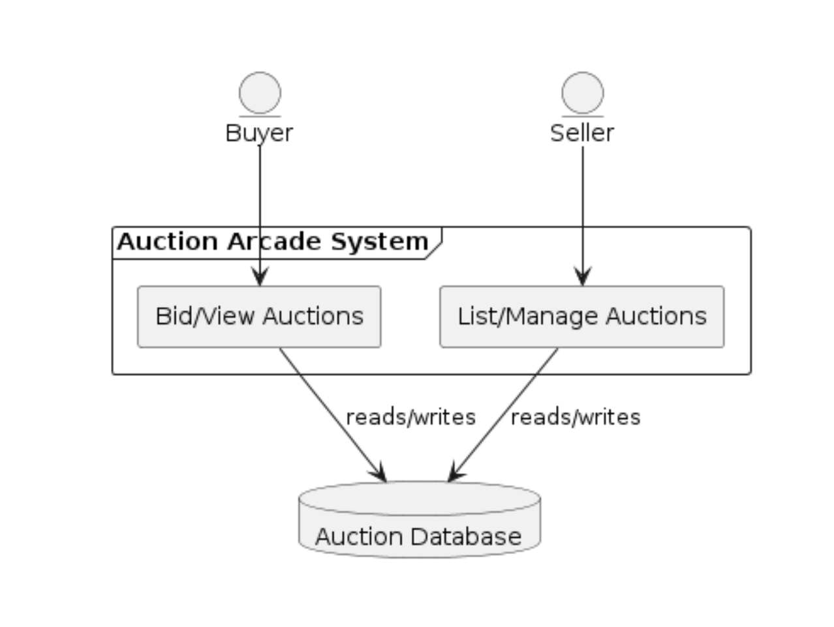
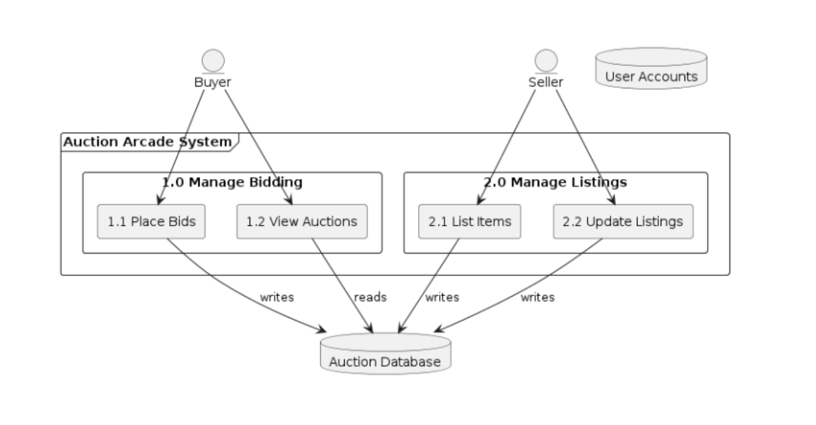
Review Data Flow
Data Flow Level 0 :
Data Flow Level 1 :

Slide 8
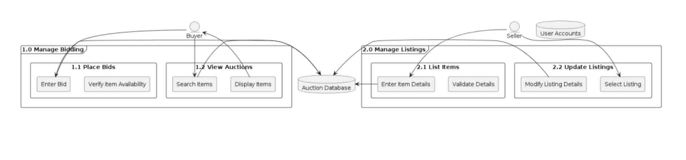
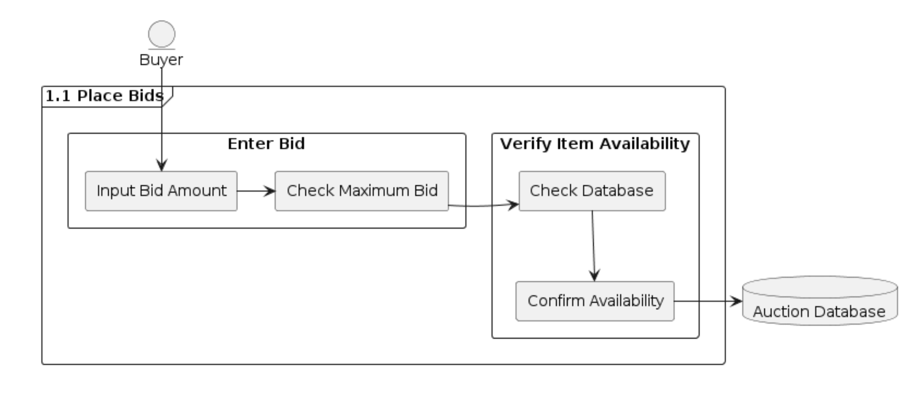
Review Data Flow
Data Flow Level 2 :
Data Flow Level 3 :

Slide 9
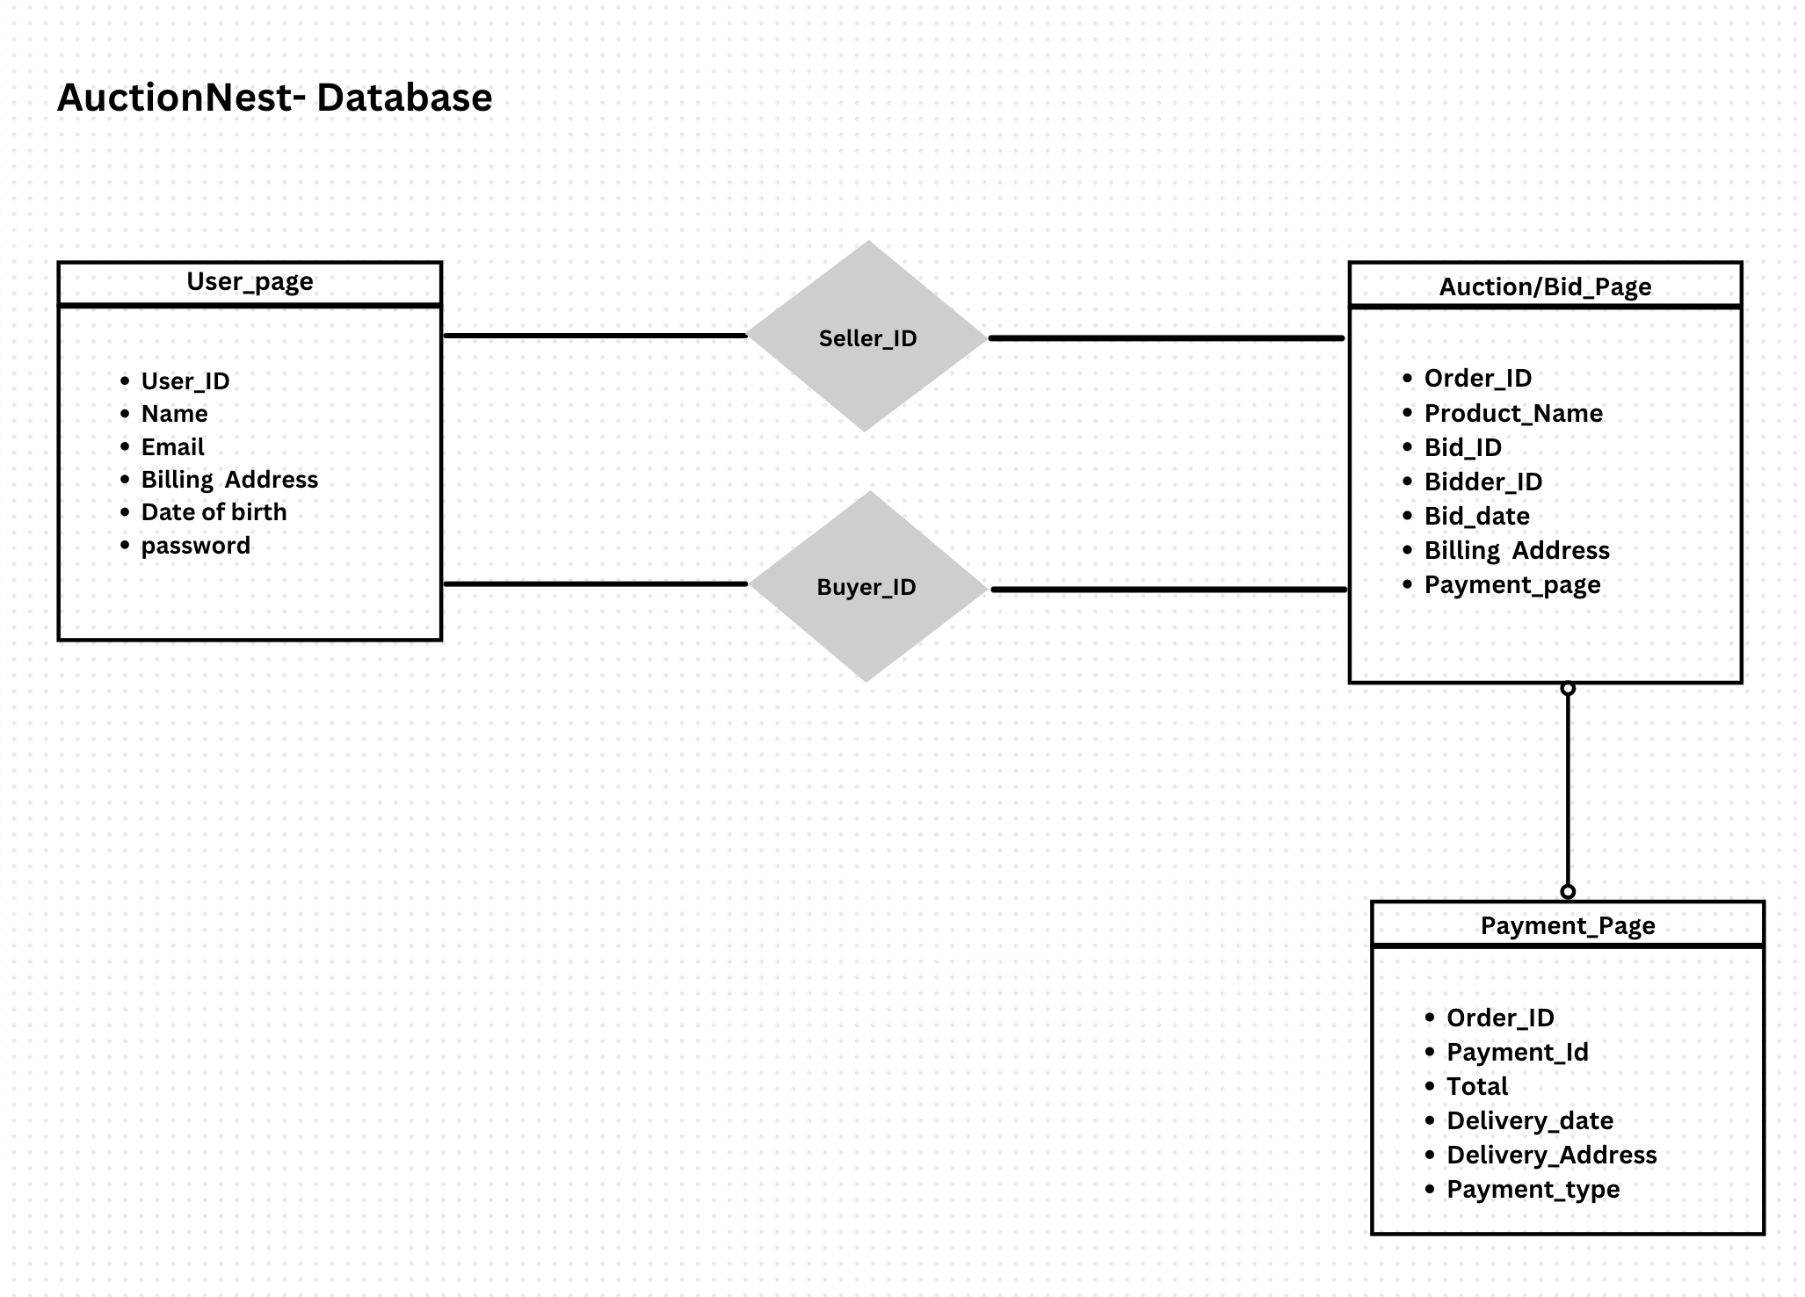
Review Database Flow

Slide 10


Participation
Sameer Shaik
Managed the secure user registration and verification module, developing processes for identity checks and ensuring compliance with privacy standards.
Focused on integrating a smooth onboarding experience, allowing users to register, buy, and sell efficiently.
Vivek Kommareddy
Oversaw the bidding system, implementing real-time updates and automated bidding options to enhance user engagement and fairness.
Optimized the payment gateway with encrypted transactions and an escrow feature, ensuring safe, reliable payment handling across multiple methods.
Prakya Tummala
Led the UI/UX design, creating a responsive and user-friendly interface across all devices, from desktop to mobile.
Developed the inventory management module within the cart, allowing users to track bids, purchases, and monitor items in real time.

Slide 11

Developing the System Design Document for Auctionnest equipped our team with valuable experience in crafting a secure and user-focused auction platform. Key lessons include:
Prioritizing Security: Integrating robust authentication and encryption for both user verification and payment processes underscored the importance of proactive security in designing online auction systems, particularly to foster user trust.
Real-Time Data Management: Handling real-time data flow for bidding and inventory tracking taught us effective methods for managing live updates, which are essential for creating a dynamic and responsive user experience in auctions.
Designing for Transparency and Trust: By focusing on clear user feedback at each stage—whether in bidding updates or payment confirmations—we reinforced the need for transparency to build a trusted community within the platform.
Scalability and Flexibility: Structuring the system with scalable components, like modular auction and payment sections, highlighted the value of flexibility for future feature integration, allowing Auctionnest to adapt to user needs and industry trends.
Learnings

Slide 12
System Complexity: Designing Auctionnest involved integrating multiple components, such as user registration, real-time bidding, and secure payment processing. Balancing these functionalities while ensuring a smooth and intuitive user experience proved to be a significant challenge for the team, requiring thorough testing and refinement.
Data Integrity and Relationships: Establishing reliable data relationships for managing user profiles, auction items, bids, and payment transactions presented complexities. Developing clear data models and ensuring data integrity throughout the bidding process were critical to maintaining a cohesive system.
User Experience Across Devices: Ensuring a consistent and responsive user experience across different devices added another layer of complexity. The team faced challenges in optimizing the interface for various screen sizes while maintaining functionality and usability, which required iterative design and user feedback.
Team Collaboration and Communication: Keeping the team aligned on roles and responsibilities was essential for project efficiency. Coordinating tasks based on each member’s strengths and ensuring open lines of communication helped address misunderstandings and maintain focus on project goals, but required continuous effort and adjustment.
Challenges

Slide 13




"With Auctionnest, technology transforms auctions into a safer, smarter, and more seamless experience for buyers and sellers alike."

Slide 14

Do you have any questions?
....

Slide 15
Thank You

